Slide 1
Dish TV India Limited
Earnings Presentation
Quarter Ended December 31, 2024
Stock Code: BSE - 532839 NSE- DISHTV LSE: DTVL

Slide 2
Disclaimer
Some of the statements made in this presentation are forward-looking statements and are based on the current beliefs, assumptions, expectations, estimates, objectives and projections of the directors and management of Dish TV India Limited about its business and the industry and markets in which it operates.
These forward-looking statements include, without limitation, statements relating to revenues and earnings. The words “believe”, “anticipate”, “expect”, “estimate", "intend”, “project” and similar expressions are also intended to identify forward looking statements. These statements are not guarantees of future performance and are subject to risks, uncertainties and other factors, some of which are beyond the control of the Company and are difficult to predict.
Consequently, actual results could differ materially from those expressed or forecast in the forward-looking statements as a result of, among other factors, changes in economic and market conditions, changes in the regulatory environment and other business and operational risks. Dish TV India Limited does not undertake to update these forward-looking statements to reflect events or circumstances that may arise after publication.

Slide 3
Key highlights for the quarter

Slide 4
Key financial highlights
Operating Revenues
Operating revenues for the quarter were Rs. 3,730 million
EBITDA
EBITDA of Rs. 1,227 million
EBITDA Margin
EBITDA margin at 32.9%
Debt
Maintained debt-free status as on December 31, 2024

Slide 5
Resilient and Changing Gears
Dish TV has not only been extremely resilient but has been strategizing changing gears to leverage its strengths including its vast distribution network, B2B expertise and pan-India presence.
Dish TV partnered with C21 Media to launch Content India 2025. The collaboration is aimed at positioning India as a global leader in content creation. The upcoming Content India 2025 would bring together industry leaders to discuss trends, challenges and opportunities in the media landscape helping support the growth of Indian content and its distribution across international platforms.
Dish TV has been strengthening the value proposition to its customers keeping its stronghold on the content distribution business reasonably well guarded from online streaming of content. Complementing direct-to-home’s erstwhile plain vanilla offering of linear television, the Company has been offering complementary OTT apps to its subscriber.
Dish TV conceived and launched the ‘Watcho Storytellers Conclave’ in Kolkata during the quarter. The trademark event aimed to foster creativity and innovation in content creation within the regional entertainment space while providing a platform for emerging storytellers to showcase their talent.
Dish TV incorporated a fully owned subsidiary under the name ‘Dish Bharat Ventures Private Limited.’ The business has been established to operate, provide, run and manage an e-commerce platform including an order management technology platform.

Slide 6
Dish TV maintains debt-free status

Slide 7
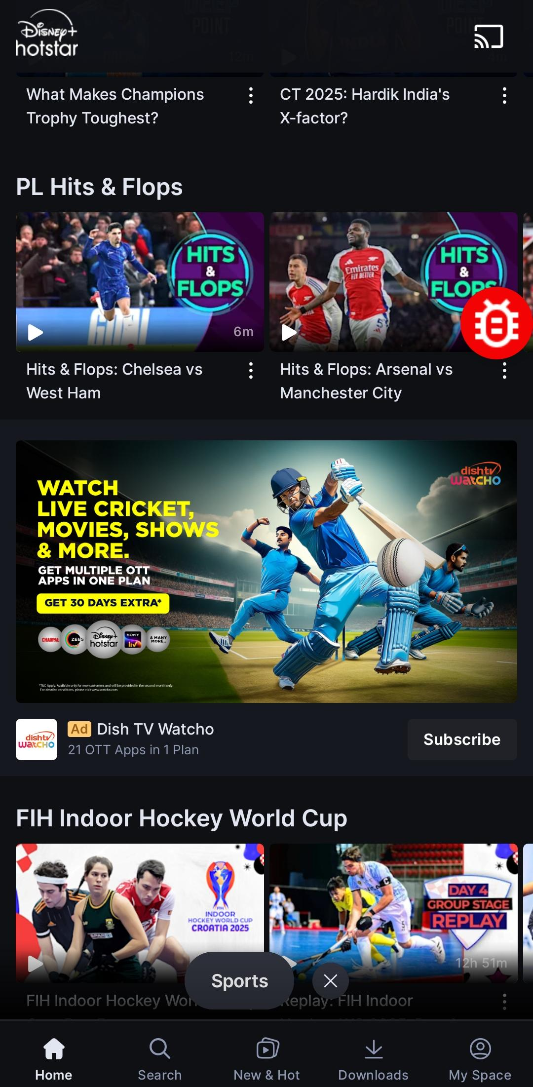
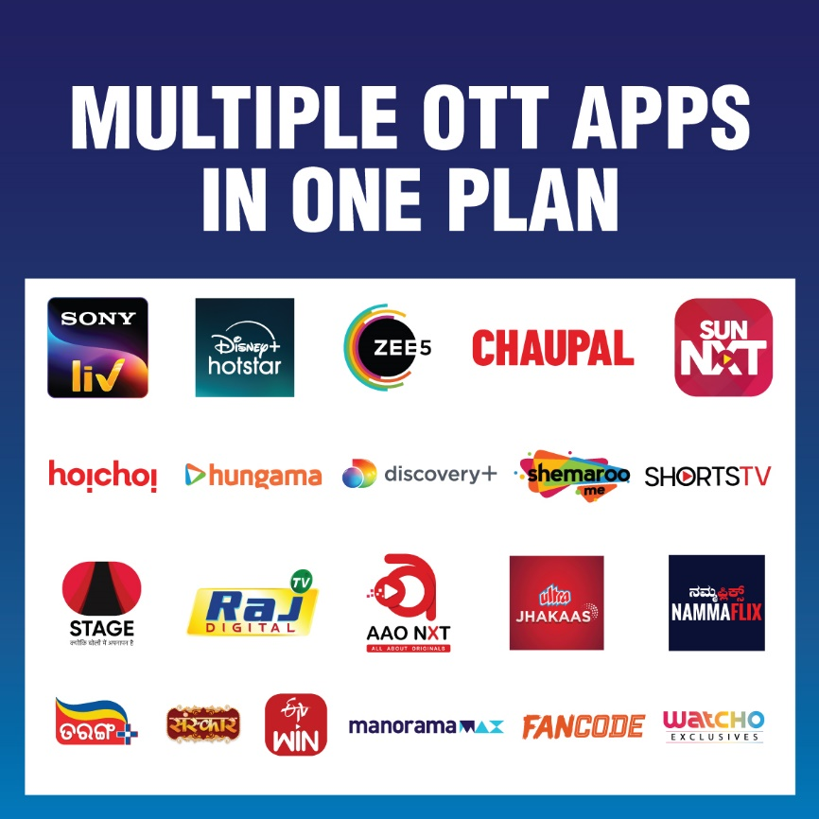
Watcho - OTT aggregation

Slide 8
Watcho - Downloads so far

Slide 9
3Q FY25 Financials

Slide 10
Quarterly performance metrics
P&L structure – 3Q FY25
Subscription revenues
Rs. 2,472 million
Operating revenues
Rs. 3,730 million
EBITDA
Rs. 1,227 million
EBITDA Margin
32.9%
EBITDA margin – 32.9%

Slide 11
Operating free cash flows
Operating free cash flows: EBITDA – Box Capex

Slide 12
Summarized consolidated P&L - Quarterly
 |  | Quarter ended | Quarter ended
Rs. million |  | December 2024 | December 2023
Operating revenues |  | 3,730 | 4,703
Expenditure |  | 2,503 | 2,899
EBITDA |  | 1,227 | 1,804
EBITDA margin (%) |  | 32.9 | 38.4
Other income |  | 90 | 43
Depreciation and amortization |  | 1,072 | 1,166
Finance cost |  | 710 | 654
Exceptional items |  | - | -
Profit / (Loss) before tax |  | (465) | 28
Tax expense:
- Current Tax |  | - | -
- Deferred Tax |  | - | 56
Net Profit / (Loss) for the period |  | (465) | (28)
Operating revenues break-up (Rs. Mn.)
3Q FY2025
Note: 1) Numbers in the table may not add up due to rounding-off. 2) Previous year figures have been regrouped wherever necessary.

Slide 13
FY24 Financials

Slide 14
Annual performance metrics
P&L structure – FY24
Subscription revenues
Rs. 14,845 million
Operating revenues
Rs. 18,565 million
EBITDA
Rs. 7,537 million
EBITDA Margin
40.6%
EBITDA margin – 40.6%

Slide 15
Summarized consolidated P&L- Annual
 |  | Year ended | Year ended
Rs. million |  | March 2024 | March 2023
Operating revenues |  | 18,565 | 22,618
Expenditure |  | 11,028 | 13,485
EBITDA |  | 7,537 | 9,134
EBITDA margin (%) |  | 40.6 | 40.4
Other income |  | 193 | 332
Depreciation |  | 4,719 | 8,491
Financial expenses |  | 2,670 | 2,780
Exceptional items |  | 4,027 | 19,076
Profit / (Loss) before tax |  | (3,686) | (20,881)
Current Tax Deferred Tax |  | - (15,979) | - (4,046)
Net Profit / (Loss) for the period |  | (19,666) | (16,835)
Operating revenues break-up (Rs. mn.)
FY 2024
Note: 1) Numbers in the table may not add up due to rounding-off. 2) Previous year figures have been regrouped wherever necessary.

Slide 16
Consolidated balance sheet
Rs. million | September 2024 (Unaudited)
Equity and liabilities
Equity
(a) Equity share capital | 1,841
(b) Other equity | (29,793)
(c) Non-controlling interest | (1)
Liabilities (1) Non-current liabilities (a) Financial liabilities
(i) Borrowings | -
(ii) Lease liabilities | 271
(iii) Other financial liabilities | -
(b) Provisions | 61
(c) Other non-current liabilities | 40
(2) Current liabilities (a) Financial liabilities
(i) Borrowings | -
(ii) Trade payables
Total outstanding dues of micro enterprises and small enterprises | 17
Total outstanding dues of creditors other than micro & small enterprises | 4,513
(iii) Lease liabilities | 147
(iv) Other financial liabilities | 924
(b) Other current liabilities | 4,065
(c) Provisions | 45,719
(d) Current tax liabilities (Net) | -
Total equity & liabilities | 27,805

Slide 17
Rs. million | September 2024 (Unaudited)
Assets
(1) Non-current assets
(a) Property, plant & equipment | 10,743
(b) Capital work in progress | 3,278
(c) Goodwill | 1
(d) Other intangible assets | 17
(e) Intangible assets under development | 747
(f) Financial assets (i) Investments | -
(ii) Loans | -
(iii) Other financial assets | 499
(g) Deferred tax assets (net) | -
(h) Current tax assets (net) | 853
(i) Other non-current assets | 3,489
(2) Current assets (a) Inventories | 97
(b) Financial assets (i) Investments (ii) Trade receivables (iii) Cash and cash equivalents (iv) Other bank balances (v) Other financial assets (c) Other current assets | 158 755 287 808 72 6,002
Total assets | 27,805

Slide 18
Thank you

